Slide 1
Acceleration
11.3 Part 2

Slide 2
Learning Goals
Calculate Acceleration using formula
Analyze Acceleration Graphs

Slide 3
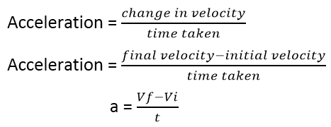
Calculating Acceleration
* Lets make sense of the formula

Slide 4
Understanding your variables
Sometimes you might see this symbol Δ. This means “Change” or “difference”. For example v_{f} – v_{i} = Δ
a
acceleration
=
t
=
time
v_{f}
Final Velocity (this is your ending or last #)
=
v_{i}
=
Initial Velocity (this is your starting or first #)

Slide 5
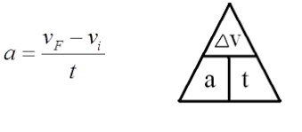
Let’s work through the problem in book
A ball rolls down a ramp, starting from rest. After 2 seconds its velocity is 6 meters per second. What is the acceleration of the ball?
1^{st – Write down the equation}
2nd ^{– List all your variables}
a =
V_{f} =
V_{i} =
t =
?
6 m/s
0 m/s
2 s

Slide 6
3rd – put the variables into your equation
a =
V_{f} =
V_{i} =
t =
?
6 m/s
0 m/s
2 s
6 m/s – 0 m/s
a=
2 s

Slide 7
Let’s make the math a little easier
Just look at the top of the equation for now (change in velocity)
6 m/s – 0 m/s
=
6 m/s
Δ v = 6 m/s

Slide 8
Now your equation looks like this
Δ v
a=
You can use a triangle to solve
time
6 m/s
a=
2 s
Answer is 3 m/s²

Slide 9
Here is a video that explains the equation – Click ME to watch

Slide 10
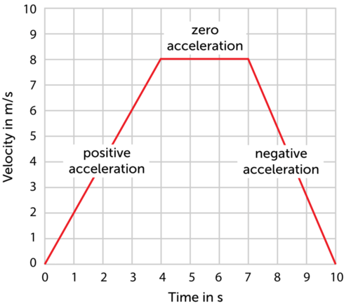
Time to look at motion graphs
You can determine acceleration by looking at graphs as well
Look at the next few graphs on acceleration – you notice patterns, you can look at the slope and determine acceleration

Slide 11
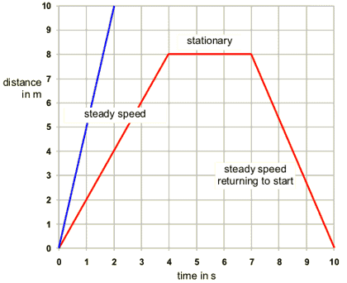

Slide 12
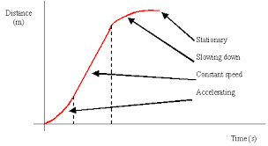

Slide 13
Here is a little video explaining the graphs – Click ME to watch
This video is a little long but does a good job explaining the graphs with good examples – Click ME to watch. At around minute 6 it gets a little difficult, just ignore his math talk

