Slide 1
Unit 6 – Basic Chemistry
Part 1 – Atomic Structure

Slide 2
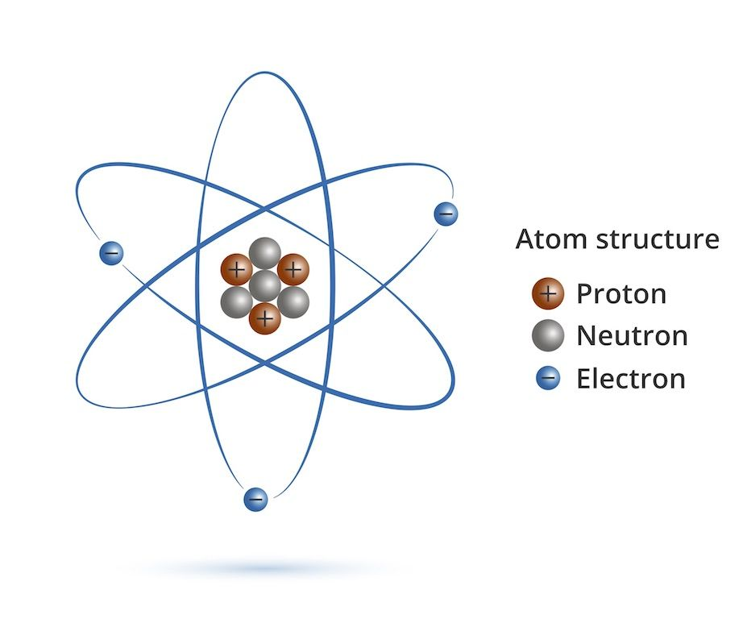
Matter: Anything that takes up space
The Smallest part of matter is called an atom

Slide 3
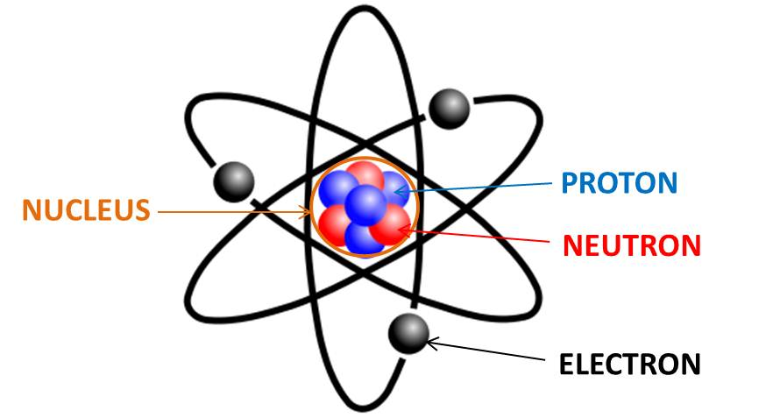
How to draw an atom
Protons and Neutrons are located in the nucleus (inside)
They can go anywhere in the nucleus, they are tightly packed together
Electrons are located on the outside
They have a very specific arrangement (we will discuss in a moment)

Slide 4
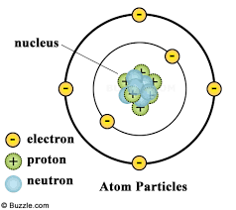
Each Subatomic particle has a charge
Protons are positive (+)
Electrons are negative (-)
Neutrons are neutral (0)

Slide 5
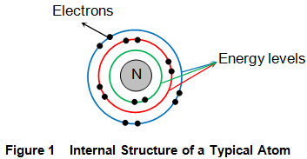
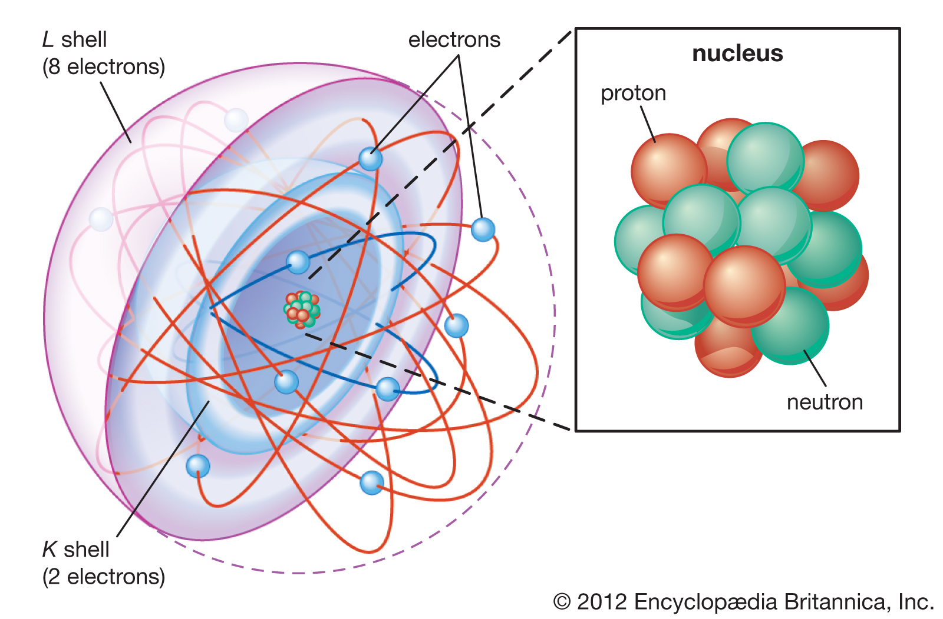
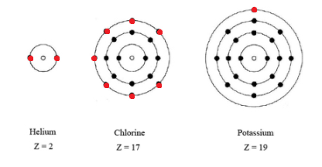
Electron Arrangement
Each level is called an Energy Level
The last level is called the valence.
This is important for bonding (we will discuss later)
The electrons are constantly moving but they stay in their energy level

Slide 6
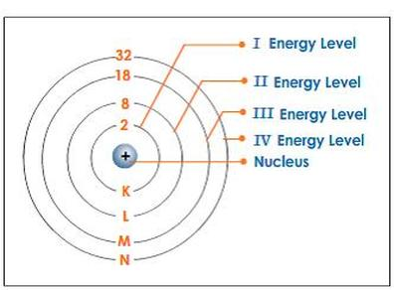
How many electrons can be in an energy level?
1st = 2
2nd = 8
3rd = 18
Video

