Slide 1
Motion: Lesson 1 – Distance and Displacement
Sit Dolor Amet

Slide 2
Introduction
For the rest of the school year we will be learning physics
The first few lessons have to do with Motion
When you read through this lecture, we suggest you take notes – there will be a short quiz that you can use your notes on
The first Lesson is on Distance and Displacement
Learning Goals:
Define distance and displacement
How are distance and displacement different?
Measure distance
Measure displacement

Slide 3
Vocabulary:
Frame of Reference
Relative Motion
Distance
Displacement

Slide 4
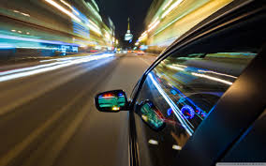
What is Motion?
Most of you would say “It’s when things move”
Well you are not wrong but we need to make it more scientific/accurate

Slide 5
Frame of Reference
To define Motion, you need to have a “starting point”
We are going to call that Frame of Reference
Almost everything moves
The Frame of Reference is the point that is NOT moving when looking at other objects that are moving

Slide 6
Frame of Reference
Click ME to watch a video on frame of reference

Slide 7
Relative Motion
Motion depends on WHO is looking at it
Therefore it depends on the Frame of Reference
You have 2 frame of reference in this picture:
The Guy ON the train
AND
The guy OFF the train
They have different frame of references, there the motion is different for each

Slide 8
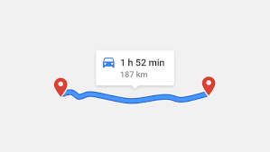
Distance
Distance: the length between 2 points

Slide 9
Measuring Distance
First of all – you are probably familiar with measuring distance in Feet or miles
BUT….. We are in science so we are going to use the metric system (meters)
Distance is the amount between 2 points, but measuring it isn’t as simple as using a ruler
You need to how far away and direction
We need to understand displacement

Slide 10
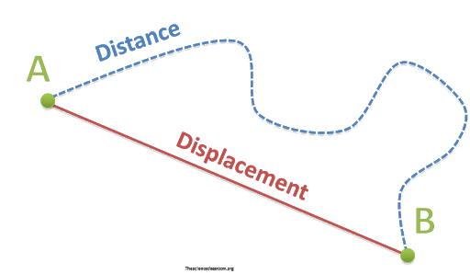
Displacement
Displacement: the direction from starting point AND the length of a straight line between points

Slide 11
Watch ME to understand the difference between distance and displacement

