Slide 1
Lesson 4-2 Evidence of Evolution
Guided Lesson Pg 211-219

Slide 2
Go to Page 211
Look at the picture and Read the Can you Explain It?
Once you completed reading… click ME to watch a little video on the Pangolin
Now that you got to see the Pangolin, you can Answer the Predict on Page 211 (Remember, you can write in your actual book, but you must type into you online book)

Slide 3
What are we learning?
In this section – we are going to be learning about different types of evidence for evolution beyond fossils
There are 3 main types of evidence
Comparing how organisms develop (embryology)
Comparing structures on current organisms (similarities)
Looking at structures that organisms have but don’t use anymore like our appendix
Comparing DNA

Slide 4
Page 212
Read the 1st Paragraph and look at the pictures
Now answer the Predict Question
Read the next Paragraph “Developmental Similarities”
Answer the “Explain”

Slide 5
Page 213
Read the 1st Paragraph and look at the pictures
Now watch this Video on this embryology – Click ME
Once you watched video, you can answer “ANALYZE”

Slide 6
Page 213-215
Read the Paragraphs on the bottom under Anatomical Evidence
On page 214 – Look at pics (you can try and do the ANNOTATE)
Read the Paragraph on Analogous Structure and look at the pictures
Once you have read, you can watch this video – Click ME
Once you watched video, you can answer “EXPLAIN” on Page 215

Slide 7
Some examples of HOMOLOGOUS Structures

Slide 8
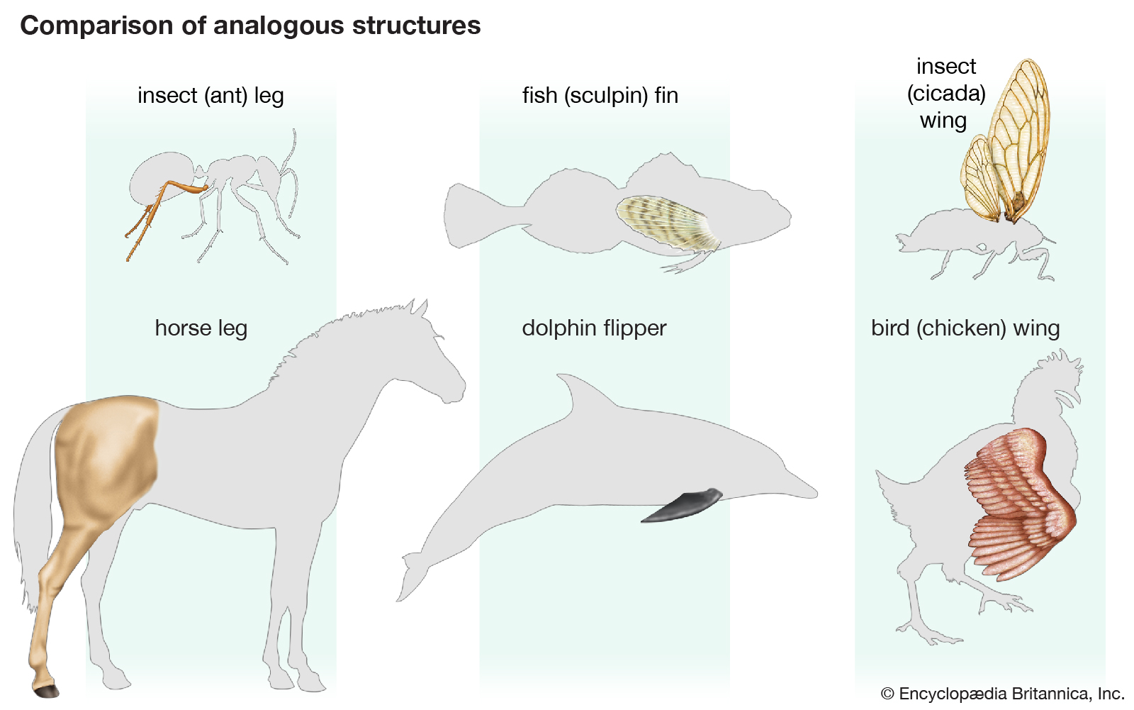
Some examples of ANALOGOUS Structures

Slide 9
Page 215
Read the paragraph on Page 215 and look at the picture
Now watch this Video on Vestigial Structures – Click ME
Once you have watched the Video, you can Answer the “ANALYZE”
Now would be a good time to do you Evidence Notebook

Slide 10
Examples of Vestigial Structures

Slide 11
Page 216 Molecular and Genetic Evidence
Read all of Page 216
Basically, many living things share the same DNA
This shows a link between them
The more similarities, the closer related they are
You can answer the EXPLAIN now

Slide 12
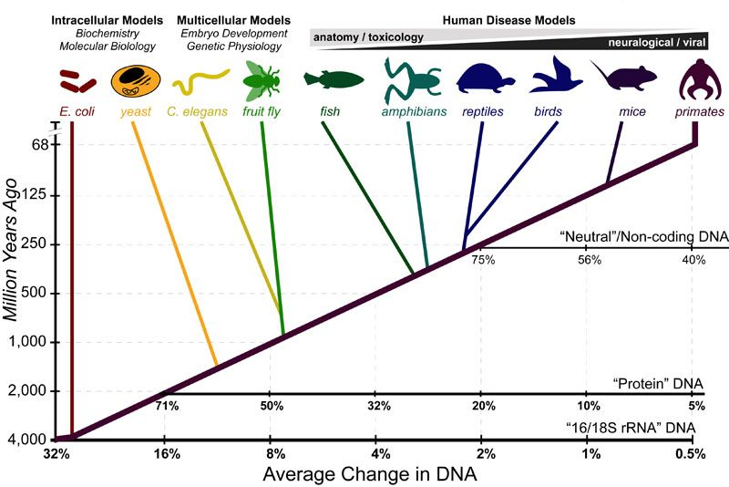
Page 216 – Molecular Clocks
Read the Paragraph on the bottom of Page 216
Now watch this video on Molecular Clock – Click ME

Slide 13
Page 217 – Mitochondrial DNA
Read the 1st Paragraph and look at the picture
Now watch this video on mitochondrial DNA – Click ME
You can now answer “ANALYZE”

Slide 14
Page 217-218
Finish Page 217 and Read through Page 218
When finished reading, complete the “ANALYZE” and “EXPLAIN” in the green box.

Slide 15
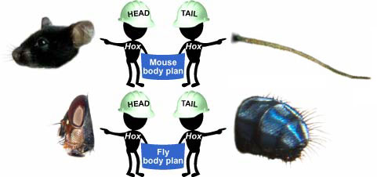
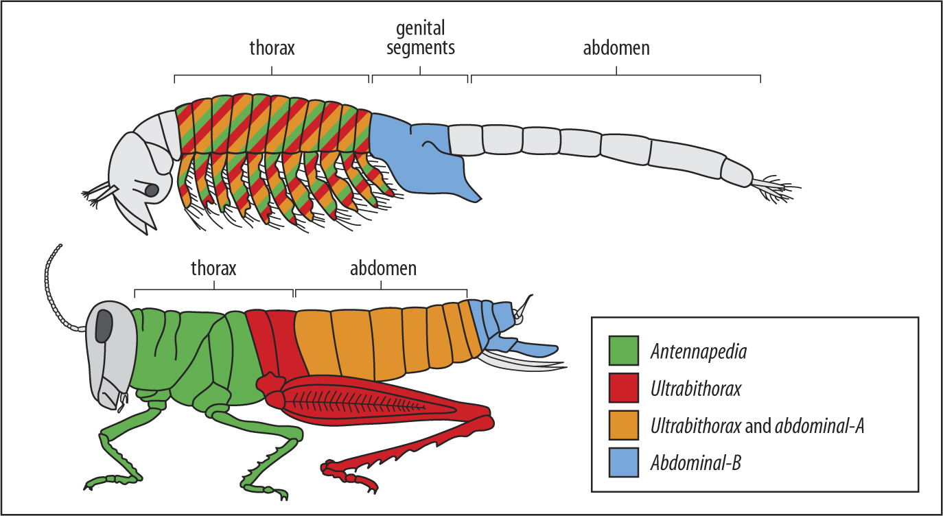
Page 219
Read all of Page 219 and look at the picture
Watch this video on Hox genes – Click ME
Now you can answer the INFER
This would be a good time to do your Evidence Notebook

Slide 16
Guess What – you are done for now
Make sure you go back to google classroom and get code for textbook quiz – it is open textbook

