Slide 1
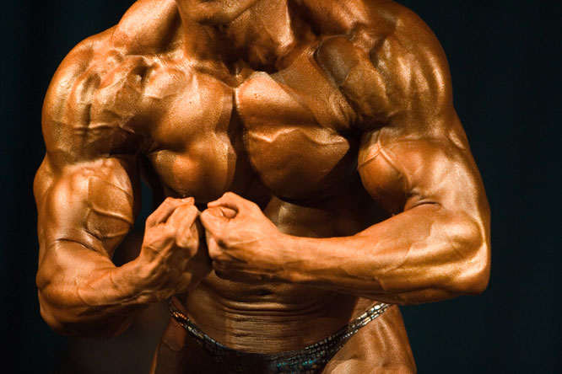
Muscles

Slide 2
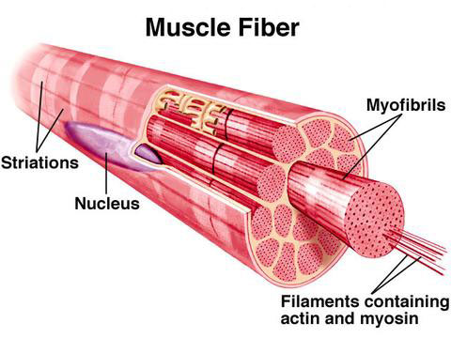
The human body is composed of over 600 muscles
Made up of bundle of tiny fibers (actin & myosin)
Fibers initiate movement when stimulated by nerves
Muscle fibers become short and think to cause movement

Slide 3
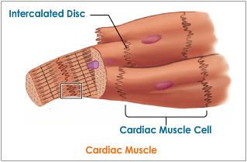
Types
Cardiac
Found only in the heart
Involuntary
Muscle Fibers are short and striations are not distinct

Slide 4
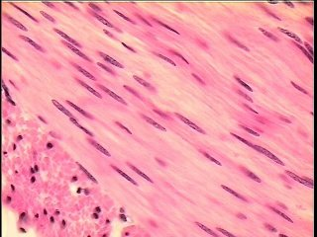
Smooth (visceral)
Found in the internal organs
Push food down tubes, control diameter of blood vessels
Sphincter Muscles are circular muscles at the opening of small intestines and esophagus, they open and close to control passage of substances
Involuntary
Fiber is long and spindle shaped, no striations
Do not tire easily, can stay contracted for long time

Slide 5
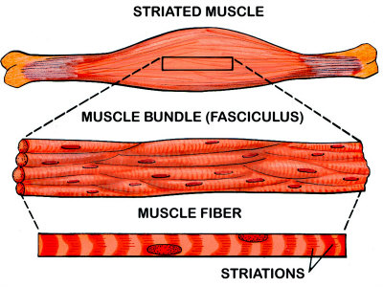
Skeletal (Striated)
Attach to bones
Voluntary
Fiber is long, cylindrical and have distinct striations

Slide 6
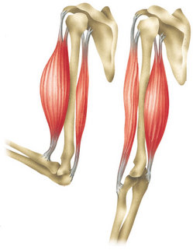
Muscle Function
Contractibility
The ability to shorten or reduce the distance between the parts
Example: When bicep contracts, the whole muscle shortens, causing the it to bring the bone closer (your elbow bends)

Slide 7
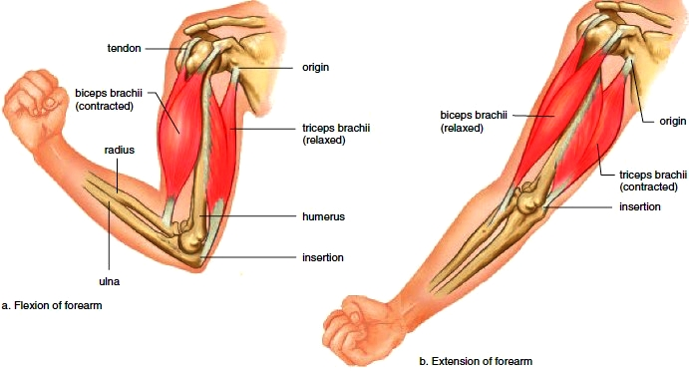
Excitability – the ability to respond to stimuli
Extensibility – the ability to lengthen and increase the distance between two parts
Example: When elbow is bent, the muscles on the back of arm are stretched

Slide 8
Elasticity – the ability to return to original form after being compressed or stretched

Slide 9
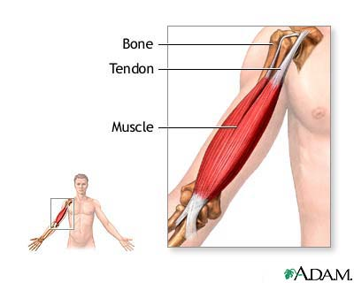
Muscle Attachments
Skeletal muscles attach to bones to allow for movement
Muscles can only pull, never push
Tendons connect the muscles to the bones
When the muscles is contracted, the bone in which it is attached will move

Slide 10
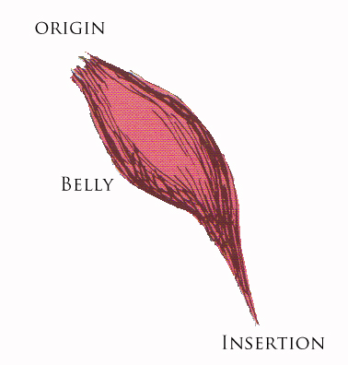
Point of Origin – The part of the skeletal muscle that is attached to the fixed part of a bone
The end where movement does not occur
Point of Insertion – the part of the skeletal muscle that is attached to the movable part of the bone
Where movement occurs
Belly – the central part of the muscle

Slide 11
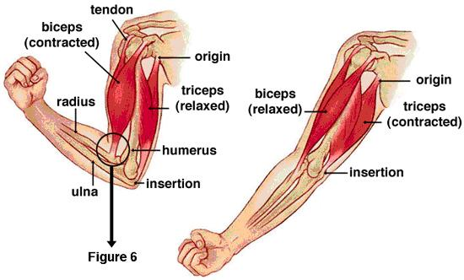
Muscle are usually arranged in pairs
One produces movement (prime mover)
The other does so in the opposite direction (antagonist)
Example: Upper arm – antagonistic
The biceps (front) - one end connects to humerus the other end the scapula
Synergists – muscles that stabilize a joint

Slide 12
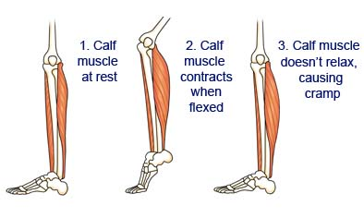
Characteristics of Muscle
Muscle fatigue - accumulation of lactic acid in the muscles
During vigorous exercise, muscle cells run out of oxygen therefore creating lactic acid through fermentation
If this continues, muscles will cramp

Slide 13
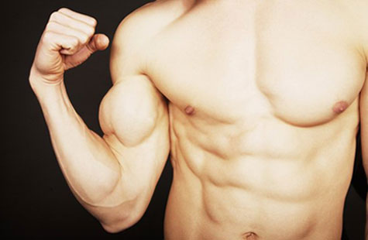
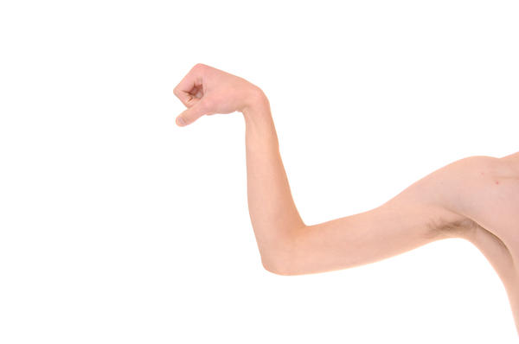
Muscle Tone – the state of partial contraction in which muscles are maintained
Slightly contracted, ready to pull
Can be achieved through proper nutrition and exercise
If muscles are not exercised, they become weak and flaccid
Muscles can shrink from disuse

Slide 14
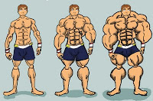
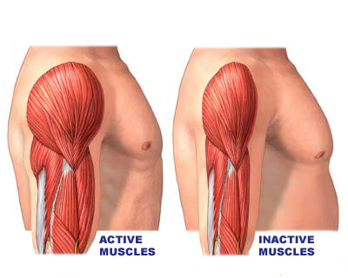
Hypertrophy – increase in mass of muscle
Most common cause is exercise
When muscles are strained, they will grow to accommodate the pressures
Atrophy – loss of muscle tissue resulting from disease or lack of use
Most common is lack of use
First lost muscle tone, then muscle mass

