Slide 1
Soft Tissue and Bone Healing

Slide 2
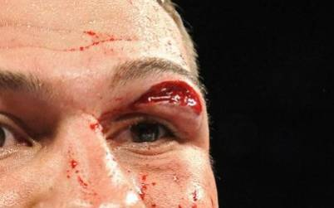
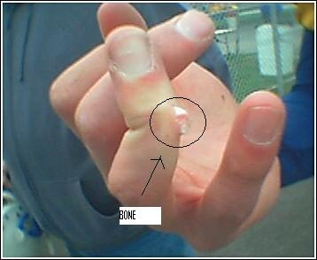
Soft Tissue vs Bone Injuries
Soft Tissue
Bone
Skin, muscle, tendons, ligaments and cartilage

Slide 3
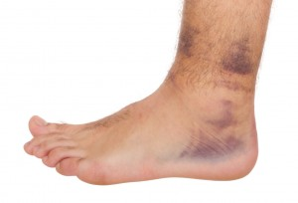
Stages of Soft-Tissue Healing

Slide 4
Stage I: Acute Inflammatory
When body part is injured -> cells within the area die
Cell death is caused because the injury deprives the area of food and oxygen.
An increase in blood flow brings chemicals and cells to area (phagocytes, leukocytes, and platelets)
Stage lasts 24-72 hours

Slide 5
Stage II: Repair
Blood, cells and chemicals are in the area to rebuild the injured structure.
Fibroblasts form a scar over the area.
Stage lasts six weeks to 3 months depending on injury.

Slide 6
Stage III: Remodeling
Stress is applied to the area to build strength.
Stage takes up to a year or more to accomplish

Slide 7
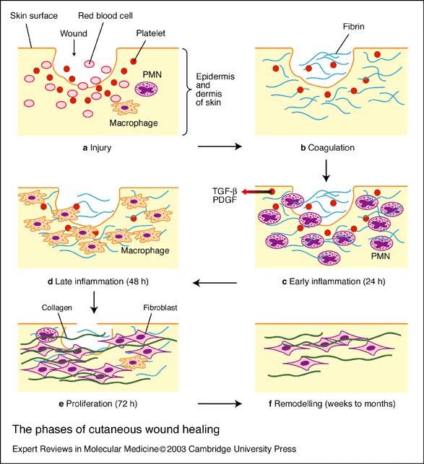

Slide 8
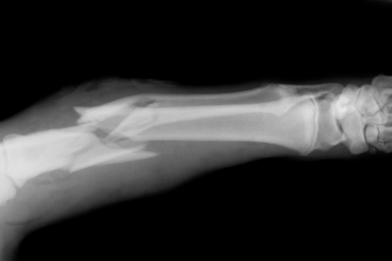
Bone Fracture Healing

Slide 9
Stage I: Acute
Break in bone -> bleeding occurs in area-> osteoclasts (absorb debris) -> osteoblasts (add layers to bone)
Four days

Slide 10
Stage II: Repair
Osteoclasts and osteoblasts continue to rebuild bone.
A fibrous callus forms holding the bone together.
1 week- 3 weeks

Slide 11
Stage III: Remodeling
The callus is reabsorbed
The callus is replaced with a fibrous matrix

Slide 12
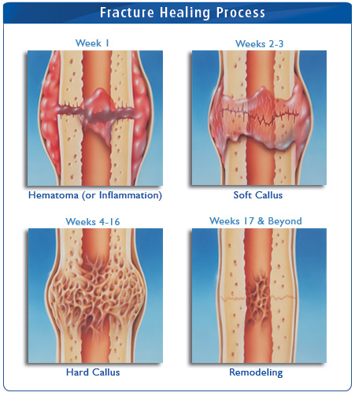

Slide 13
Factors that Slow Down the Healing Process
Poor nutrition
Illnesses (Example: Diabetes)
Medication (Corticorsteriods)
Excessive scar tissue
Returning to play too soon

