Slide 1
SPORTS PSYCHOLOGY

Slide 2
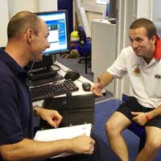
Sports Psychology
The study of the effect of variables such as life stress, mood and motivation on sport performance and sport-related injury

Slide 3
Sport Psychologist
Research to understand how variables affect performance
Teach coaches, athletes, athletic trainers and other health care professionals psychological techniques to improve performance
Work to help deal with stress

Slide 4
Depression
The feeling of despair or hopelessness
Causes: Biological (genetic), Environmental (traumatic childhood), and sociological (injury)
S/Sxs: Lack of appetite, nausea, indigestion, headaches, dizziness, and susceptibility to cold and other illnesses

Slide 5
Post-Traumatic Response
A sustained emotional disorder that results from a very traumatic and stressful experience
Ex: AT dealing with an athlete who suffered a spinal cord injury
S/Sxs: Loss of concentration, depression, loss of appetite, and disrupted sleep

Slide 6
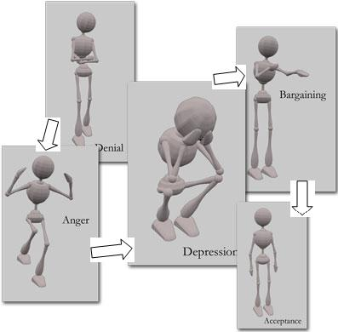
When an Athlete is Injured
The following stages represent the emotional response that an athlete will have to an injury or loss:
- Denial
- Anger
- Bargaining
- Depression
- Acceptance

Slide 7
Coping With Injury- Modeling
An injured athlete has a successfully rehabilitated athlete with a similar injury to observe
Once the injured athlete sees the progress, he/she will be motivated to do the rehabilitation.

Slide 8
Coping with Injury- Physical Environment (WHICH ONE WOULD YOU PREFER?)
Bright
Clean
Cheerful
Pleasant
Dark
Smelly
Noisy
Grim

Slide 9
Coping with Injury- Relaxation in Athletics
Imagery- Envision a successful task
Examples: Visualizing the muscle fibers rebuilding
Seeing the swelling pushed into the lymphatic system

